Slide 1
COMP3074 Mobile App Development I
Week 3

Slide 2
Today
More views
Themes and Styles
Fragments

Slide 3
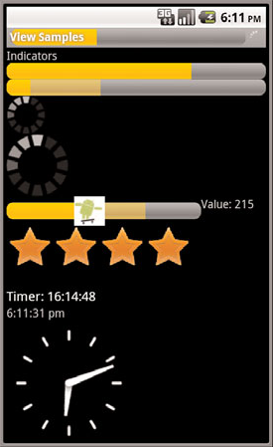
Progress Indicators
The Android SDK provides several types of progress bars.
The standard progress bar is a circular indicator that only animates.
It only shows that something is taking place
There are three sizes of this type of progress indicator
A basic indeterminate progress bar:
<ProgressBar
android:id=”@+id/progress_bar”
android:layout_width=”wrap_content”
android:layout_height=”wrap_content” />
The default style is for a medium-size circular progress indicator
Notes:
http://developer.android.com/reference/android/widget/ProgressBar.html

Slide 4
Progress Indicators
Two other styles for indeterminate progress bar are progressBarStyleLarge and progressBarStyleSmall.
This style animates automatically
When the value reaches the maximum value, the indicators fade away so that they aren’t visible.
The following code demonstrates how to place this type of indeterminate progress indicator on your Activity screen:
requestWindowFeature(Window.FEATURE_INDETERMINATE_PROGRESS);
requestWindowFeature(Window.FEATURE_PROGRESS);
setContentView(R.layout.indicators);
setProgressBarIndeterminateVisibility(true);
setProgressBarVisibility(true);
setProgress(5000);

Slide 5
Progress Indicators
We can set the indicator progress status programmatically as follows:
Progress = (ProgressBar) findViewById(R.id.progress_bar);
Progress.setProgress(75);
Setting the progress to 75 shows the indicator at 75 percent complete

Slide 6
Progress Indicators
The second type is a horizontal progress bar that shows the completeness of an action.
For example, you can see how much of a file is downloading.
This horizontal progress bar can also have a secondary progress indicator on it
This example shows the layout definition for a horizontal progress indicator:
<ProgressBar android:id="@+id/progressbar"
android:layout_width="fill_parent"
android:layout_height="wrap_content"
style="@android:style/Widget.ProgressBar.Horizontal" />

Slide 7
Adjusting Progress with SeekBar
SeekBar looks like the regular horizontal progress bar, but includes a thumb, or selector, that can be dragged by the user.
A default thumb selector is provided, but you can use any drawable item as a thumb.
<SeekBar
android:id=”@+id/seekbar1”
android:layout_height=”wrap_content”
android:layout_width=”240px”
android:max=”500” />

Slide 8
Adjusting Progress with SeekBar
To show the user what exact value the user is selecting
Just provide an implementation of the onProgressChanged() method:
SeekBar seek = (SeekBar) findViewById(R.id.seekbar1);
seek.setOnSeekBarChangeListener(
new SeekBar.OnSeekBarChangeListener()
{ //start anonymous class
public void onProgressChanged(
SeekBar seekBar, int progress,boolean fromTouch)
{
((TextView)findViewById(R.id.seek_text)).setText(“Value: “+progress);
seekBar.setSecondaryProgress((progress+seekBar.getMax())/2);
}
});

Slide 9
Displaying Rating Data with RatingBar
RatingBar has a more specific purpose: showing ratings or getting a rating from a user:
Here’s an example of an XML layout resource definition for a RatingBar with four stars:
<RatingBar android:id=”@+id/ratebar1”
android:layout_width=”wrap_content”
android:layout_height=”wrap_content”
android:numStars=”4”
android:stepSize=”0.25” />
Here, users can choose any rating value between 0 and 4.0, but only in increments of 0.25, the stepSize value

Slide 10
Displaying Rating Data with RatingBar
To show a numeric representation of this value to the user implement
onRatingChanged() method of the RatingBar.OnRatingBarChangeListener class.
RatingBar rate = (RatingBar) findViewById(R.id.ratebar1);
rate.setOnRatingBarChangeListener(new
RatingBar.OnRatingBarChangeListener()
{
public void onRatingChanged(RatingBar ratingBar,
float rating, boolean fromTouch)
{
((TextView)findViewById(R.id.rating_text)).setText(“Rating: “+ rating);
}
});

Slide 11
Working with Styles
For example, by using a style, you can take this layout XML:
<TextView android:layout_width="fill_parent" android:layout_height="wrap_content" android:textColor="#00FF00" android:typeface="monospace" android:text="@string/hello" />
And turn it into this:
<TextView style="@style/CodeFont" android:text="@string/hello" />

Slide 12
Working with Styles
Here’s an example of a simple style resource file /res/values/styles.xml containing two styles:
one for mandatory form fields, and one for optional form fields on TextView and EditText objects:
<?xml version=”1.0” encoding=”utf-8”?>
<resources>
<style name=”mandatory_text_field_style”>
<item name=”android:textColor”>#000000</item>
<item name=”android:textSize”>14pt</item>
<item name=”android:textStyle”>bold</item>
</style>
<style name=”optional_text_field_style”>
<item name=”android:textColor”>#0F0F0F</item>
<item name=”android:textSize”>12pt</item>
<item name=”android:textStyle”>italic</item>
</style>
</resources>

Slide 13
Working with Styles
Here’s the styles.xml file again; this time, the color and text size fields are available in the other resource files: colors.xml and dimens.xml:
<?xml version=”1.0” encoding=”utf-8”?>
<resources>
<style name=”mandatory_text_field_style”>
<item name=”android:textColor”>@color/mand_text_color</item>
<item name=”android:textSize”>@dimen/important_text</item>
<item name=”android:textStyle”>bold</item>
</style>
<style name=”optional_text_field_style”>
<item name=”android:textColor”>@color/opt_text_color</item>
<item name=”android:textSize”>@dimen/unimportant_text</item>
<item name=”android:textStyle”>italic</item>
</style>
</resources>

Slide 14
Working with Styles
You can set each control’s style attribute by referencing it as:
style=”@style/name_of_style”
For example:
<TextView
android:id=”@+id/TextView01”
style=”@style/mandatory_text_field_style”
android:layout_height=”wrap_content”
android:text=”@string/mand_label”
android:layout_width=”wrap_content” />

Slide 15
Working with Themes
Themes are like styles, but instead of being applied to one layout element at a time, they are applied to all elements of a given activity.
Themes are defined in exactly the same way as styles.
Themes use the <style> tag and should be stored in the /res/values directory.
The only difference is that instead of applying that named style to a layout element, you define it as the theme attribute of an activity in the AndroidManifest.xml file

Slide 16
Working with Themes
To set a theme for all the activities of your application, open the AndroidManifest.xml file and edit the <application> tag to include the android:theme attribute with the style name. For example:
<application android:theme="@style/CustomTheme">
To apply a theme to just one Activity in your application, add the android:theme attribute to the <activity> tag instead:
<activity android:theme="@android:style/CustomTheme">
You can inherit built-in themes. For example:
<activity android:theme="@android:style/Theme.Dialog">
will make your activity to look like a dialog box

Slide 17
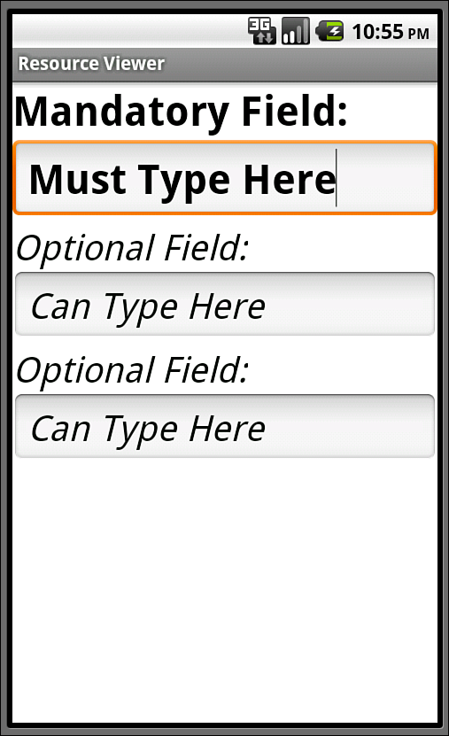
Styles Example
StylesTest app
Notes:
StylesThemes Follow instructions and fix the Manifest files. Android Styles and Themes Example docx.
Let’s create a theme for the activity different the entire app ?

Slide 18
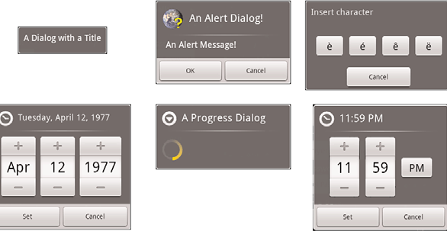
Working with Dialogs
The different dialog types available in Android

Slide 19
Working with Dialogs
An Activity uses the following methods to manage a Dialog:
showDialog() method is used to display a Dialog.
dismissDialog() method is used to stop showing a Dialog.
The Dialog is kept around in the Activity’s Dialog pool.
If the Dialog is shown again using showDialog(), the cached version is displayed once more.
removeDialog() method is used to remove a Dialog from the Activity objects Dialog pool.
The Dialog is no longer kept around for future use.
If you call showDialog() again, the Dialog must be re-created.

Slide 20
Working with Dialogs
It is up to the developer to override the onCreateDialog() method of the Activity and return the appropriate Dialog for a given identifier.
If an Activity has multiple Dialog windows, the onCreateDialog() method generally contains a switch statement to return the appropriate Dialog based on the incoming parameter—the Dialog identifier
It might be important to re-initialize a Dialog each time it is shown, instead of just when it is created the first time.
For this purpose, you can override the onPrepareDialog() method of the Activity

Slide 21
Designing UI with Views
Objectives:
Using Data-Driven Containers
Using Drawings and Animations in Android Apps

Slide 22
Using Data-Driven Containers
Data-Driven Containers are all types of AdapterView controls.
An AdapterView control contains a set of child View controls to display data from some data source.
An Adapter generates these child View controls from a data source
An Adapter reads data from some data source and provides a View object based on some rules, depending on the type of Adapter used.
This View is used to populate the child View objects of a particular AdapterView

Slide 23
Using Data-Driven Containers
The most common Adapter classes are the CursorAdapter and the ArrayAdapter.
The CursorAdapter gathers data from a Cursor, whereas the ArrayAdapter gathers data from an array.
A CursorAdapter is a good choice to use when using data from a database.
The ArrayAdapter is a good choice to use when there is only a single column of data or when the data comes from a resource array.

Slide 24
Using the ArrayAdapter
An ArrayAdapter binds each element of the array to a single View object within the layout resource.
Here is an example of creating an ArrayAdapter:
String[] programs = {
"Software Engineering Technology",
"Interactive Gaming",
"Health Informatics Technology",
"Software Systems Design"
};
ArrayAdapter<String> adapter = new ArrayAdapter<String>(this,
android.R.layout.simple_dropdown_item_1line, programs);
AutoCompleteTextView textView = (AutoCompleteTextView)
findViewById(R.id.txtPrograms);
textView.setThreshold(3);
textView.setAdapter(adapter);

Slide 25
Using the CursorAdapter
A CursorAdapter binds one or more columns of data to one or more View objects within the layout resource provided.
The CursorAdapter requires the use of a Cursor.

Slide 26
Using the CursorAdapter
The following example demonstrates creating a CursorAdapter by querying the Contacts content provider.
Cursor names = managedQuery(
Contacts.Phones.CONTENT_URI, null, null, null, null);
startManagingCursor(names);
ListAdapter adapter = new SimpleCursorAdapter(
this, R.layout.two_text, names, new String[] {
Contacts.Phones.NAME, Contacts.Phones.NUMBER}, new int[] {R.id.scratch_text1,R.id.scratch_text2});
SimpleCursorAdapter enables us to match up columns in the database with particular controls in our layout.
For each row returned from the query, we get one instance of the layout within our AdapterView.

Slide 27
Binding Data to the AdapterView
Apply the Adapter object to one of the AdapterView controls.
Here is an example of this with a ListView:
((ListView)findViewById(R.id.list)).setAdapter(adapter);
The call to the setAdapter() method of the AdapterView, a ListView in this case, should come after your call to setContentView().
This is all that is required to bind data to your AdapterView.

Slide 28
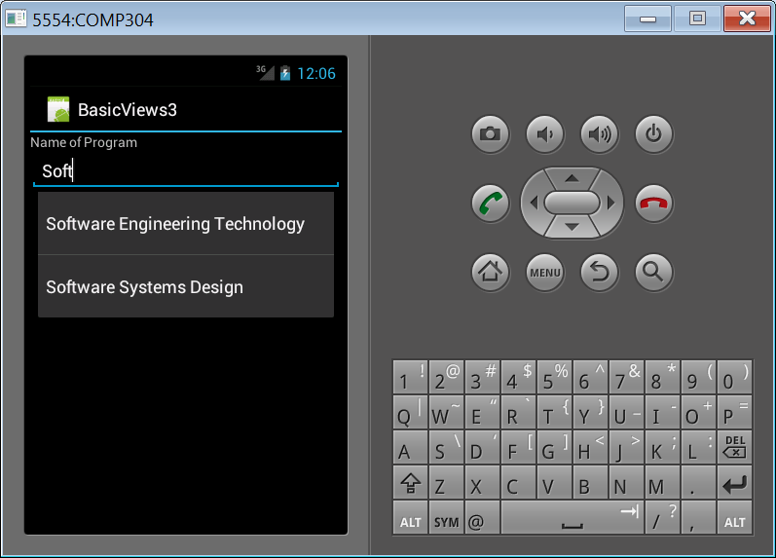
Binding Data to the AdapterView
Figure below shows binding data to an ArrayAdapter
Let’s complete the ListView.

Slide 29
Handling Selection Events
ListView, and GridView—enable your application to monitor for click events in the same way.
You need to call setOnItemClickListener() on your AdapterView and pass in an implementation of the AdapterView.OnItemClickListener class.
Here is an example implementation of this class:
listView.setOnItemClickListener(
new AdapterView.OnItemClickListener() {
public void onItemClick(
AdapterView<?> parent, View view,
int position, long id) {
Toast.makeText(Scratch.this, “Clicked _id=”+id,
Toast.LENGTH_SHORT).show();
}
});

Slide 30
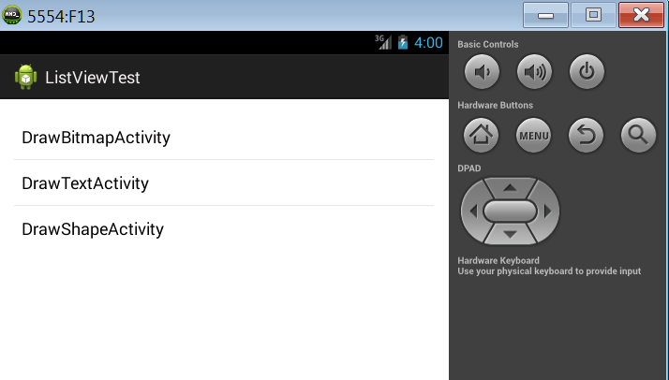
ListView example

Slide 31
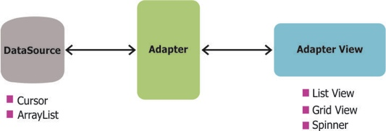
Adapter
An Adapter object acts as a bridge between an AdapterView and the underlying data for that view. The Adapter provides access to the data items. The Adapter is also responsible for making a View for each item in the data set.
Understanding Adapters in Android
http://www.edureka.co/blog/what-are-adapters-in-android/

Slide 32
Create ListView
In this android example creating a simple listview to display an array values.
activity_list_view_android_example.xml File
<LinearLayout xmlns:android=http://schemas.android.com/apk/res/android
android:layout_width="match_parent"
android:layout_height="match_parent"
android:orientation="vertical" >
<ListView
android:id="@+id/list"
android:layout_height="wrap_content"
android:layout_width="match_parent">
</ListView>
</LinearLayout>
Explanation :
Define ListView in xml file

Slide 33
Create ListView
Get ListView from Module 5 and run the application, try to understand the logic.
Adapters are used to provide the data to the ListView.
Parameters:
Reference to a built-in XML layout document that is part of the Android OS, rather than one of your own XML layouts
simple_list_item_1 : Android internal layout view.
android.R.id.text1 : In Android internal layout view already defined text fields to show data.
values : User defined data array.
Notes:
ListViewExample from Module 5

Slide 34
ListView
The difference is the following. simple_list_item_1 contains only a TextView, whereas simple_list_item_2 has two inside a subclass of RelativeLayout. These are both taken from Jelly Bean.
Check the link below to see what it says:
http://stackoverflow.com/questions/11722885/what-is-difference-between-android-r-layout-simple-list-item-1-and-android-r-lay
simple_list_item_1 vs. simple_list_item_2
The difference is the following. simple_list_item_1 contains only a TextView, whereas simple_list_item_2 has two inside a subclass of RelativeLayout. These are both taken from Jelly Bean.
Using simple_list_item_2 will add additional line.

Slide 35
Using the CursorAdapter
A CursorAdapter binds one or more columns of data to one or more View objects within the layout resource provided.
The CursorAdapter requires the use of a Cursor.

Slide 36
Using CursorAdapters
Android provides adapter classes specifically to display data from an SQLite database query:
SimpleCursorAdapter – Similar to an ArrayAdapter because it can be used without subclassing. Simply provide the required parameters (such as a cursor and layout information) in the constructor and then assign to a ListView.
CursorAdapter – A base class that you can inherit from when you need more control over the binding of data values to layout controls (for example, hiding/showing controls or changing their properties).
Cursor adapters provide a high-performance way to scroll through long lists of data that are stored in SQLite. The consuming code must define an SQL query in a Cursor object and then describe how to create and populate the views for each row.

Slide 37
Using the CursorAdapter
The following example demonstrates creating a CursorAdapter by querying the Contacts content provider.
Cursor names = managedQuery(
Contacts.Phones.CONTENT_URI, null, null, null, null);
startManagingCursor(names);
ListAdapter adapter = new SimpleCursorAdapter(
this, R.layout.two_text, names, new String[] {
Contacts.Phones.NAME, Contacts.Phones.NUMBER}, new int[] {R.id.scratch_text1,R.id.scratch_text2});
SimpleCursorAdapter enables us to match up columns in the database with particular controls in our layout.
For each row returned from the query, we get one instance of the layout within our AdapterView

Slide 38
Using CursorAdapters
The PDF document in Module 6, CursorAdapter, demonstrate cursor adapters requires a simple SQLite database implementation. The code in SimpleCursorTableAdapter/VegetableDatabase.cs contains the code and SQL to create a table and populate it with some data.
Notes:
CursorAdapter PDF from Module 6

Slide 39
Using the ListActivity
The ListView control is commonly used for full-screen menus or lists of items from which a user selects.
As such, you might consider using ListActivity as the base class for such screens.
First, to handle item events, you now need to provide an implementation in your ListActivity.
For instance, the equivalent of onListItemClickListener is to implement the onListItemClick() method within your ListActivity.
Second, to assign an Adapter, you need a call to the setListAdapter() method.
You do this after the call to the setContentView() method.

Slide 40
Using the ListActivity
To use ListActivity, the layout that is set with the setContentView() method must contain a ListView with the identifier set to android:list; this cannot be changed.
Second, you can also have a View with an identifier set to android:empty to have a View display when no data is returned from the Adapter.
Finally, this works only with ListView controls, so it has limited use.
Notes:
http://android.vexedlogic.com/2011/04/02/android-lists-listactivity-and-listview-i-basic-usage/
http://examples.javacodegeeks.com/android/core/app/listactivity/android-listactivity-example/

Slide 41
Using the ListActivity
The Android ListActivity makes it simple to display a list of items in your application. If the main purpose of a screen (Activity) in your mobile application is to present a list of choices or content to the user, use ListActivity instead of Activity.
If all you want to do is display a list to the user and nothing more, you don’t even need to create a layout definition for the activity.
The ListActivity has a default layout that provides a ListView for you.
However, if you wish to customize the way your ListActivity looks, the single required element in your layout definition is an object with an id of @android:id/list.
Notes:
http://android.vexedlogic.com/2011/04/02/android-lists-listactivity-and-listview-i-basic-usage/
http://examples.javacodegeeks.com/android/core/app/listactivity/android-listactivity-example/

Slide 42
Drawing on the Screen
To use the canvas just display the View like any other layout.
In the onCreate() method use the following code:
setContentView(new ViewWithRedDot(this));

Slide 43
Drawing on the Screen
Canvas objects are used for drawing.
Create a subclass of the View class and write the drawing code in onDraw() method.
private static class ViewWithRedDot extends View {
public ViewWithRedDot(Context context) {
super(context);
}
@Override
protected void onDraw(Canvas canvas) {
canvas.drawColor(Color.BLACK);
Paint circlePaint = new Paint();
circlePaint.setColor(Color.RED);
canvas.drawCircle(canvas.getWidth()/2,
canvas.getHeight()/2,
canvas.getWidth()/3, circlePaint);
}
}

Slide 44
Drawing on the Screen
To use the canvas just display the View like any other layout.
In the onCreate() method use the following code:
setContentView(new ViewWithRedDot(this));

Slide 45
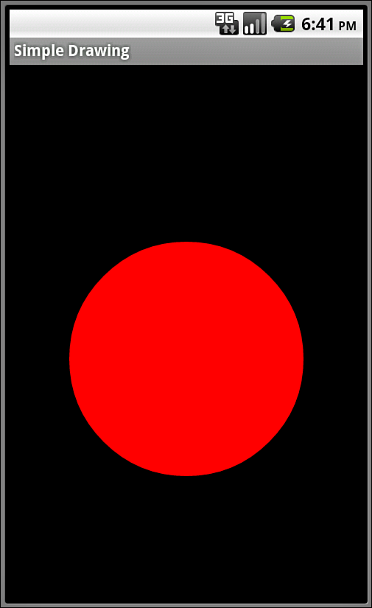
Drawing on the Screen
The ViewWithRedDot view draws a red circle on a black canvas background.

Slide 46
Drawing on the Screen
The Canvas (android.graphics.Canvas) contains the necessary methods available for drawing images, text, shapes, and support for clipping regions.
The dimensions of the Canvas are bound by the container view.
You can retrieve the size of the Canvas using the getHeight() and getWidth() methods.
Paint (android.graphics.Paint) class encapsulates the style and complex color and rendering information, which can be applied to a drawable like a graphic, shape, or piece of text in a given Typeface.

Slide 47
Drawing on the Screen
You can set the color of the Paint using the setColor() method.
Standard colors are predefined within the android.graphics.Color class.
For example, the following code sets the paint color to red:
Paint redPaint = new Paint();
redPaint.setColor(Color.RED);
The following code instantiates a Paint object with antialiasing enabled:
Paint aliasedPaint = new Paint(Paint.ANTI_ALIAS_FLAG);

Slide 48
Working with Paint Styles
Paint style controls how an object is filled with color.
For example, the following code instantiates a Paint object and sets the Style to STROKE, which signifies that the object should be painted as a line drawing and not filled (the default):
Paint linePaint = new Paint();
linePaint.setStyle(Paint.Style.STROKE);

Slide 49
Canvas and Paint
Android provides a set of APIs for 2D-drawing that allow you to render your custom graphics on a canvas or modify the existing Views. When drawing 2D graphics, you have two choices to work with:
Let’s get the example CanvasExample3 from Week 6!
How to add red circle when we start the application and still be able to continue to draw myself ?
Let’s add logic to the clear button.
Notes:
http://examples.javacodegeeks.com/android/core/graphics/canvas-graphics/android-canvas-example/
CanvasExample

Slide 50
Working with Paint Gradients
You can create a gradient of colors using one of the gradient subclasses.
The different gradient classes, including LinearGradient, RadialGradient, and SweepGradient, are available under the superclass android.graphics.Shader.
All gradients need at least two colors—a start color and an end color—but might contain any number of colors in an array.
The different types of gradients are differentiated by the direction in which the gradient “flows.”
Gradients can be set to mirror and repeat as necessary.
You can set the Paint gradient using the setShader() method.
Notes:
If ANTI_ALIAS_FLAG bit is set AntiAliasing smooths out the edges of what is being drawn, but is has no impact on the interior of the shape.

Slide 51
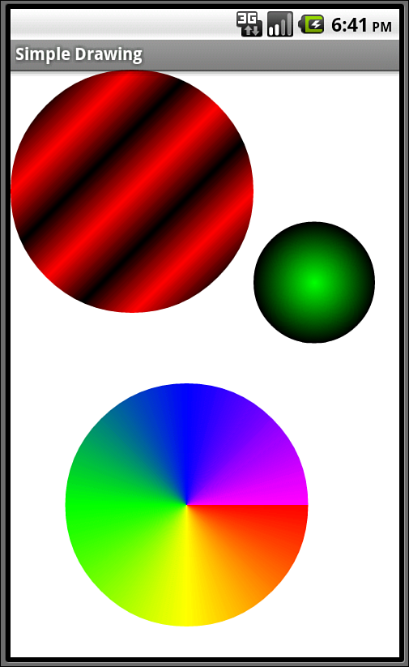
Working with Paint
An example of a LinearGradient (top), a RadialGradient (right), and a SweepGradient
(bottom).

Slide 52
Working with Linear Gradients
A linear gradient is one that changes colors along a single straight line.
You can achieve this by creating a LinearGradient and setting the Paint method setShader() before drawing on a Canvas, as follows:
Paint circlePaint = new Paint(Paint.ANTI_ALIAS_FLAG);
linGrad = new LinearGradient(0, 0, 25, 25,
Color.RED, Color.BLACK,
Shader.TileMode.MIRROR);
circlePaint.setShader(linGrad);
canvas.drawCircle(100, 100, 100, circlePaint);
Get LinearGradient from Week 6 and run it ?
Test the Sweep as well (current commented out!).
How to add text view to the layout ? LinearGradient2
Notes:
LinearGradient from Week 6
LinearGradient2 through activity_main XML or dynamically in the Java code.

Slide 53
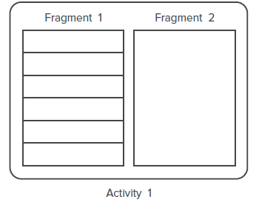
FRAGMENTS
A fragment is a mini activity.
An activity can have many fragments to contain views.

Slide 54
FRAGMENTS
Fragments are Java classes and load their UIs from corresponding XML files
A fragment extends the Fragment base class:
public class Fragment1 extends Fragment {
}
To add a fragment to an activity, you use the <fragment> element
<?xml version=”1.0” encoding=”utf-8”?>
<LinearLayout xmlns:android=”http://schemas.android.com/apk/res/android”
android:layout_width=”fill_parent”
android:layout_height=”fill_parent”
android:orientation=”horizontal” >
<fragment
android:name=”net.learn2develop.Fragments.Fragment1”
android:id=”@+id/fragment1”
android:layout_weight=”1”
android:layout_width=”0px”
android:layout_height=”match_parent” />
………..

Slide 55
FRAGMENTS
You can add fragments dynamically to activities during runtime.
FragmentManager class
FragmentTransaction class
FragmentManager fragmentManager = getFragmentManager();
FragmentTransaction fragmentTransaction =
fragmentManager.beginTransaction();
//---get the current display info---
WindowManager wm = getWindowManager();
Display d = wm.getDefaultDisplay();
if (d.getWidth() > d.getHeight())
{
//---landscape mode---
Fragment1 fragment1 = new Fragment1();
// android.R.id.content refers to the content
// view of the activity
fragmentTransaction.replace(
android.R.id.content, fragment1);
}

Slide 56
FRAGMENTS
else
{
//---portrait mode---
Fragment2 fragment2 = new Fragment2();
fragmentTransaction.replace(
android.R.id.content, fragment2);
}
fragmentTransaction.commit();
Fragments From Module 6.

Slide 57
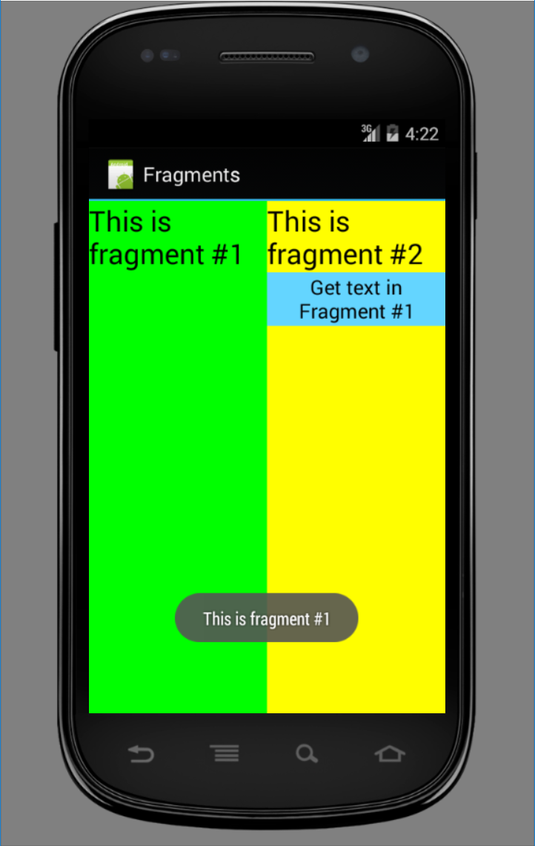
FRAGMENTS

Slide 58
Fragment’s life cycle
When a fragment is being created, it goes through the following states:
➤ onAttach() - fragment is associated with its activity
➤ onCreate() - initial creation of the fragment
➤ onCreateView() – creates fragment view
➤ onActivityCreated() – its activity finished onCreate
When the fragment becomes visible, it goes through these states:
➤ onStart() - makes the fragment visible to the user
➤ onResume() - makes the fragment interacting with the user

Slide 59
Fragment’s life cycle
When the fragment goes into the background mode, it goes through these states:
➤ onPause()
➤ onStop()
When the fragment is destroyed (when the activity it is currently hosted in is destroyed), it goes through the following states:
➤ onPause() - fragment is no longer interacting with the user
➤ onStop() - fragment is no longer visible to the user
➤ onDestroyView() - clean up resources associated with its View
➤ onDestroy() - final cleanup of the fragment's state
➤ onDetach() – before the fragment no longer being associated with its activity

Slide 60
Fragment’s life cycle
Like activities, you can restore an instance of a fragment using a Bundle object, in the following states:
➤ onCreate()
➤ onCreateView()
➤ onActivityCreated()

Slide 61
Interactions between Fragments
Example:
you can obtain the activity in which a fragment is currently embedded by first using the getActivity() method and then using the findViewById() method to locate the view(s) contained within the fragment:
TextView lbl = (TextView)
getActivity().findViewById(R.id.lblFragment1);
Toast.makeText(getActivity(), lbl.getText(),
Toast.LENGTH_SHORT).show();
Use getView(). This will return the root view for the fragment, with this you can call findViewById().

Slide 62
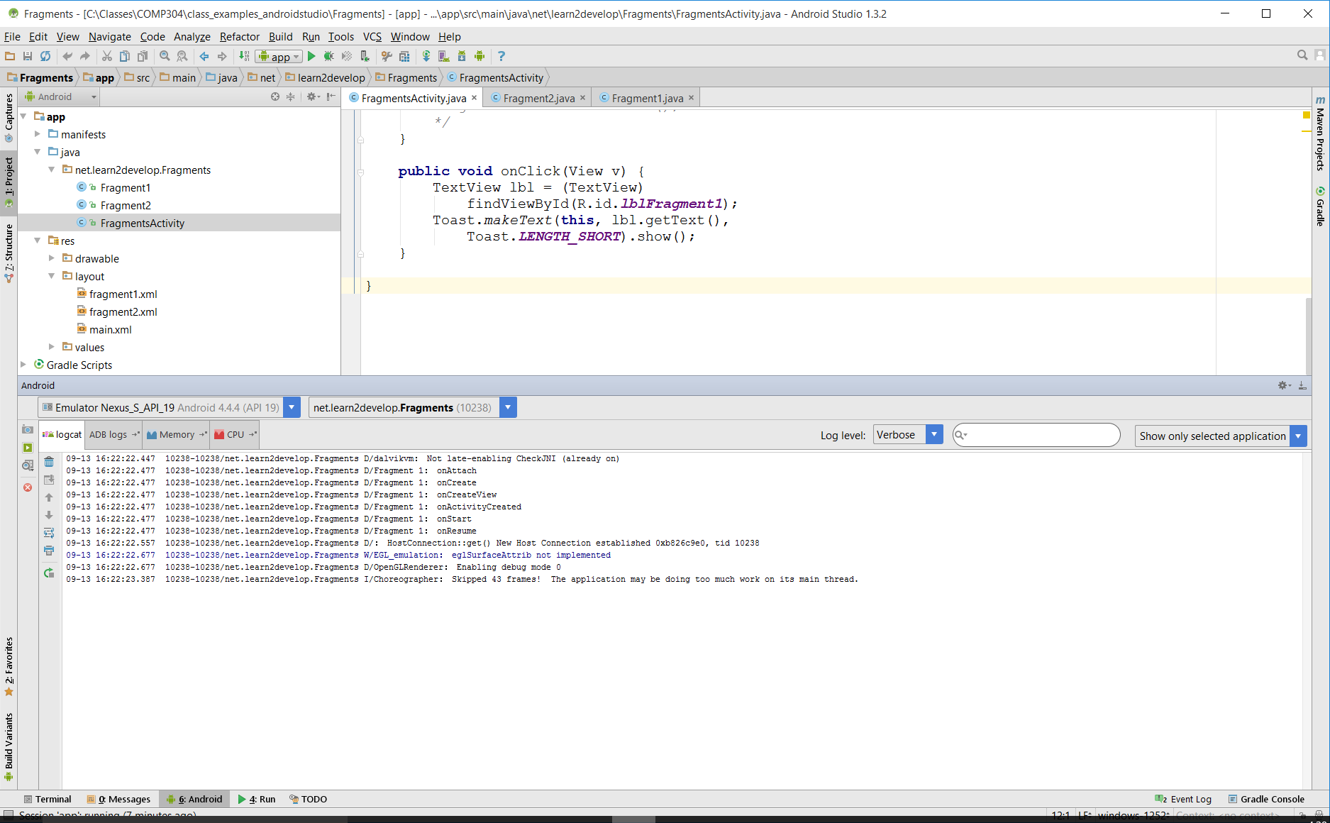
Interactions between Fragments

Slide 63
Building a Dynamic UI with Fragments
To create a dynamic and multi-pane user interface on Android, you need to encapsulate UI components and activity behaviors into modules that you can swap into and out of your activities.
You can create these modules with the Fragment class, which behaves somewhat like a nested activity that can define its own layout and manage its own lifecycle.
You can think of a fragment as a modular section of an activity.
Fragment has its own lifecycle, receives its own input events, and which you can add or remove while the activity is running (sort of like a "sub activity" that you can reuse in different activities).
Notes:
https://developer.android.com/training/basics/fragments/index.html

Slide 64
Building a Flexible UI
When designing your application to support a wide range of screen sizes, you can reuse your fragments in different layout configurations to optimize the user experience based on the available screen space.
For example, on a handset device it might be appropriate to display just one fragment at a time for a single-pane user interface.
Conversely, you may want to set fragments side-by-side on a tablet which has a wider screen size to display more information to the user.
https://developer.android.com/training/basics/fragments/fragment-ui.html
Notes:
https://developer.android.com/training/basics/fragments/index.html

Slide 65
Google Play Style Tabs using TabLayout
Tabs are now best implemented by leveraging the ViewPager with a custom "tab indicator" The best way is to use Google's new TabLayout included in the support design library release for Android "M".
Prior to Android "M", the easiest way to setup tabs with Fragments was to use ActionBar Tabs as described in ActionBar Tabs with Fragments guide. However, all methods related to navigation modes in the ActionBar class (such as setNavigationMode(), addTab(), selectTab(), etc.) are now deprecated.
Swipe views provide lateral navigation between sibling screens such as tabs with a horizontal finger gesture (a pattern sometimes known as horizontal paging).
Notes:
https://developer.android.com/training/animation/screen-slide.html
https://guides.codepath.com/android/Sliding-Tabs-with-PagerSlidingTabStrip

Slide 66
ViewPager With Screen Slide & Tabs
Let’s follow the example below
https://guides.codepath.com/android/google-play-style-tabs-using-tablayout
SlidingTabsLayout2 Example
https://developer.android.com/training/implementing-navigation/lateral.html
Notes:
https://developer.android.com/training/animation/screen-slide.html
https://guides.codepath.com/android/Sliding-Tabs-with-PagerSlidingTabStrip

Slide 67
ViewPager With Screen Slide & Tabs
Let’s follow the example below
http://www.tutorialwebz.com/tutorial/google-play-style-tabs-using-tablayout/
SlidingTabsLayout Example
Notes:
https://developer.android.com/training/animation/screen-slide.html
https://guides.codepath.com/android/Sliding-Tabs-with-PagerSlidingTabStrip

Slide 68
Fragment’s Communication
Communicating with Other Fragments
Often you will want one Fragment to communicate with another, for example to change the content based on a user event. All Fragment-to-Fragment communication is done through the associated Activity. Two Fragments should never communicate directly.
http://developer.android.com/training/basics/fragments/communicating.html
Notes:
Assign 3

Slide 69
References
Textbook
Android Documentation
https://developer.android.com/guide/components/fundamentals.html
http://developer.android.com/tools/studio/index.html
https://developer.android.com/training/basics/firstapp/creating-project.html

